Slide 1
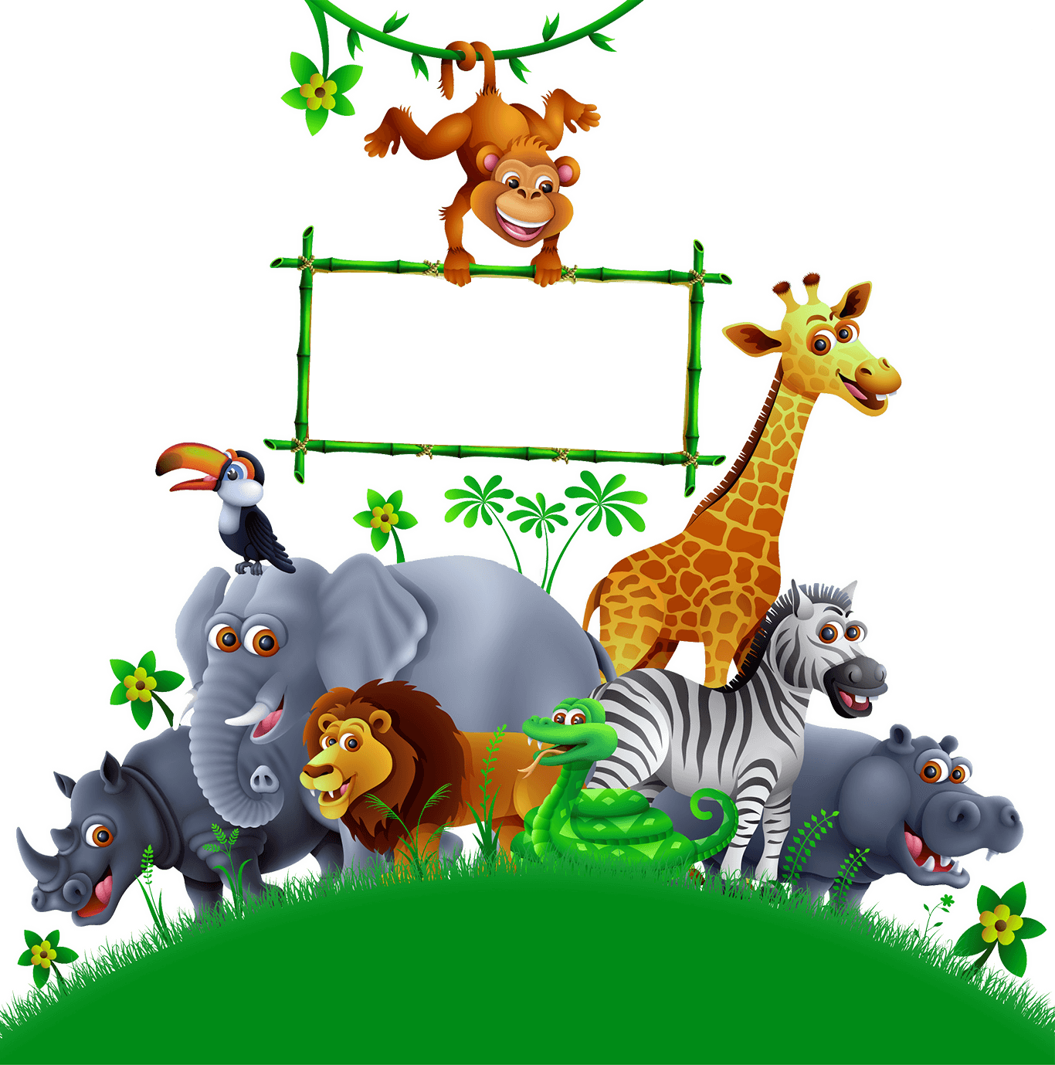


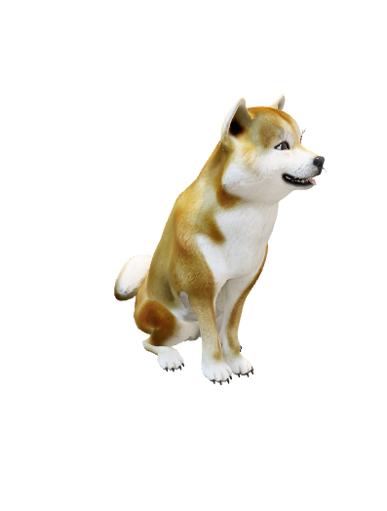
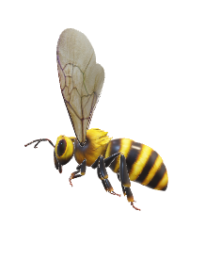
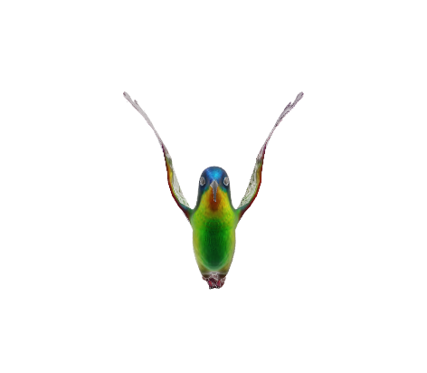
MY ANIMAL DIARY
A-Z of animals and their groups
Open My Diary >>>
Open diary to begin
IMAGINA

Slide 2
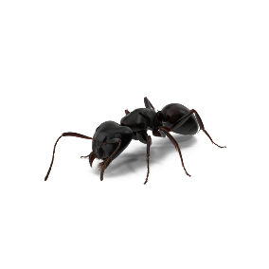
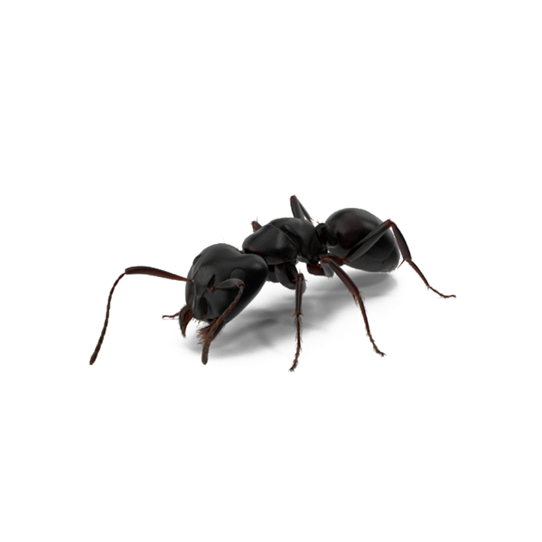



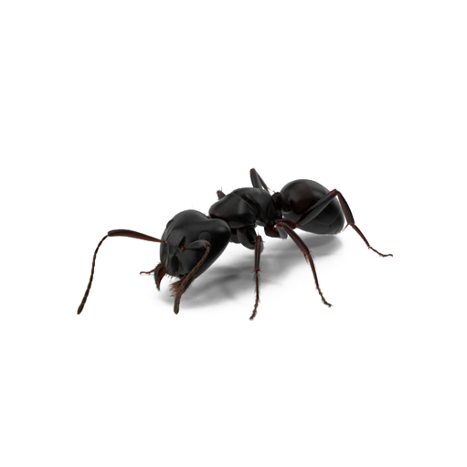

Aa Ant
A COLONY of Ants
IMAGINA

Slide 3
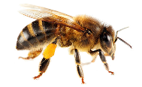
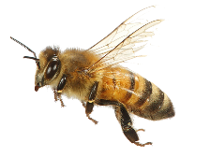


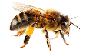










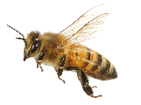
Bb Bee
A SWARM of Bees
IMAGINA

Slide 4

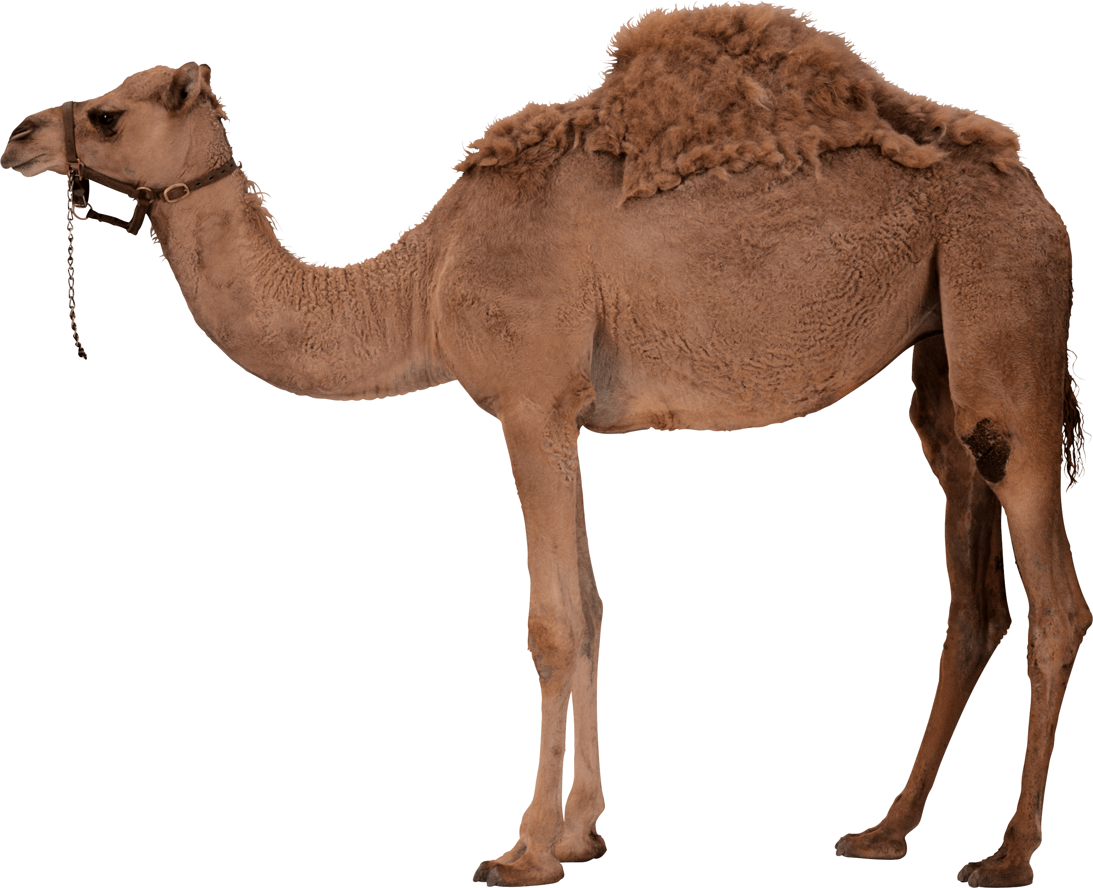
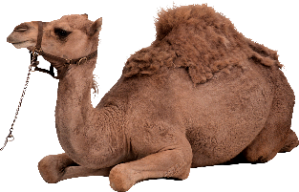
Cc Camel
A CARAVAN of Camels
IMAGINA

Slide 5

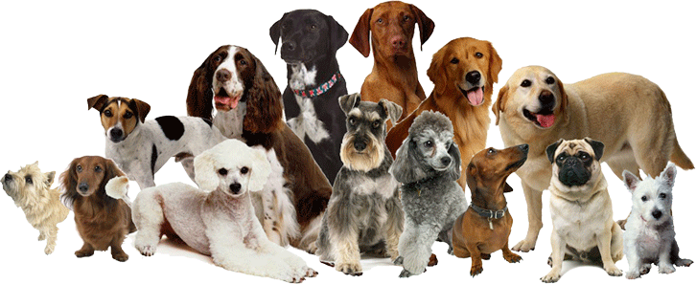
Dd Dog
A PACK of Dogs
IMAGINA

Slide 6
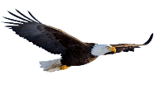
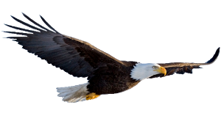




Ee Eagle
A CONVOCATION of Eagles
IMAGINA

Slide 7
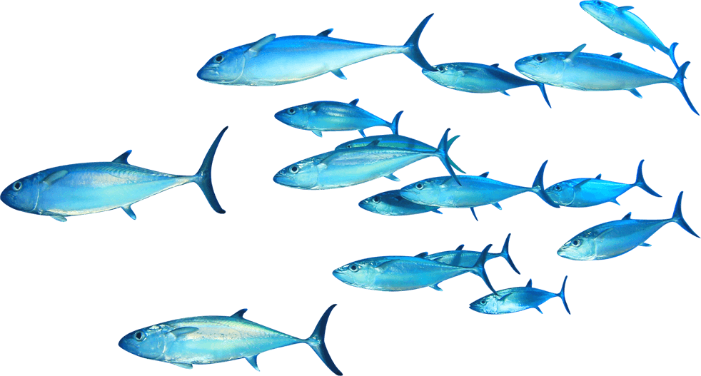
Ff Fish
A SCHOOL of Fish
IMAGINA

Slide 8
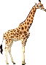
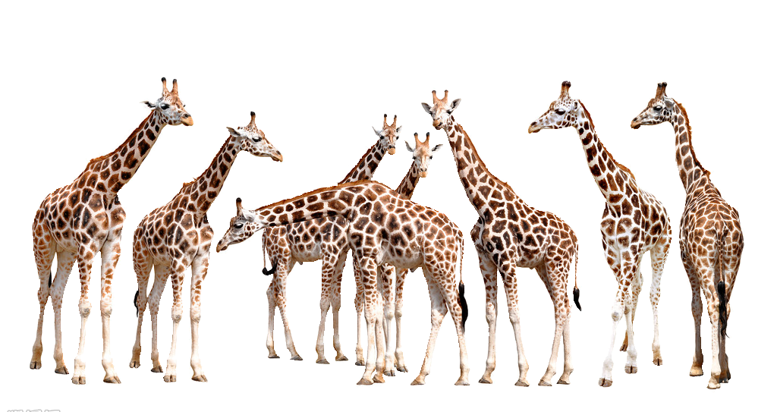
Gg Giraffe
A TOWER of Giraffes
IMAGINA

Slide 9
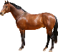
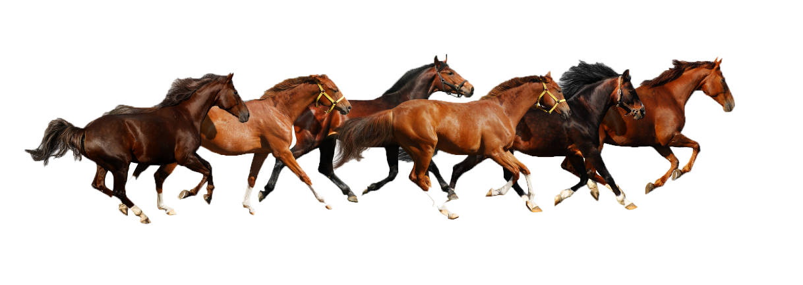

Hh Horse
A TEAM of Horses
IMAGINA

Slide 10
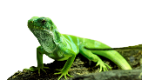
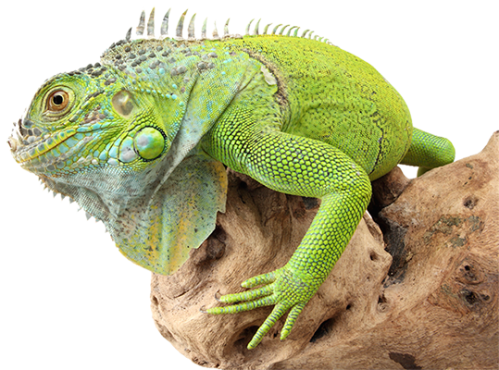
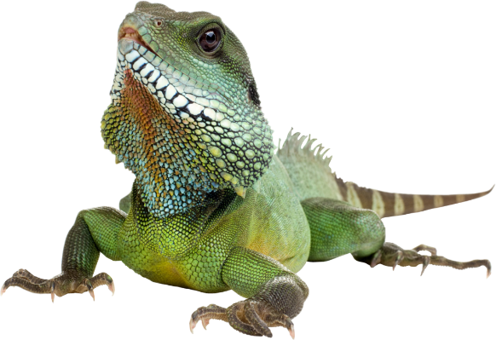


Ii Iguana
A SLAUGHTER of Iguanas
IMAGINA

Slide 11

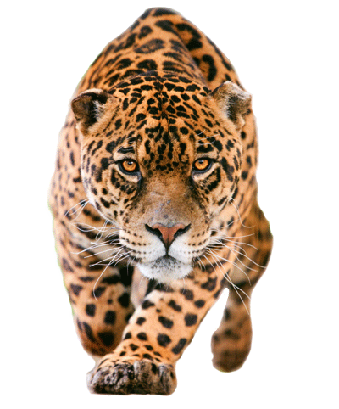
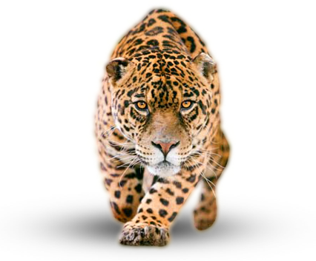
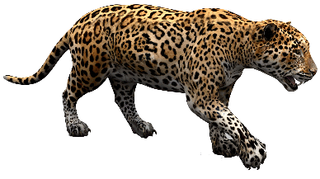

Jj Jaguar
A SHADOW of Jaguars
IMAGINA

Slide 12
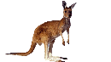
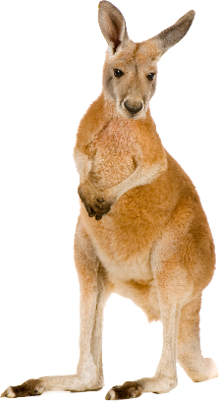
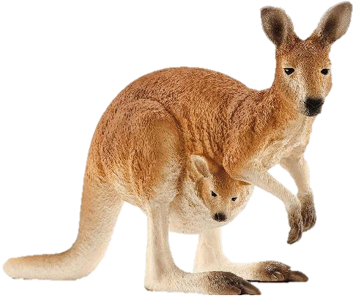
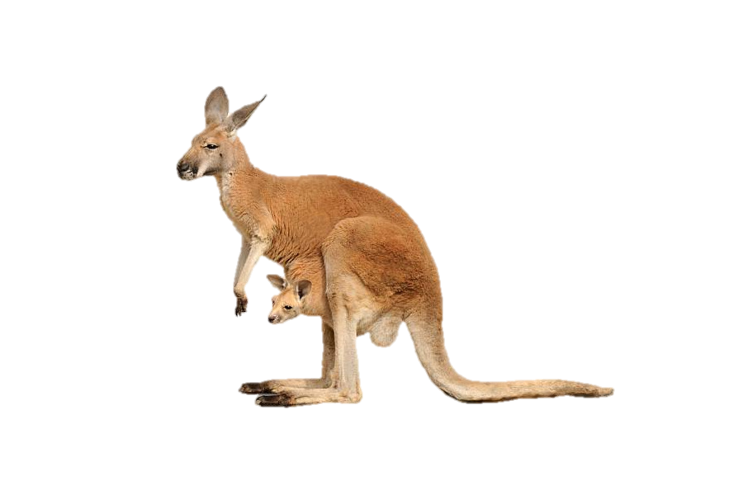
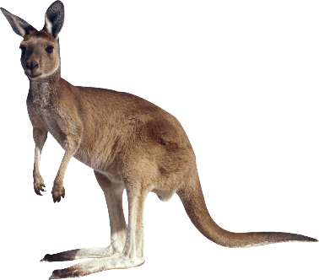
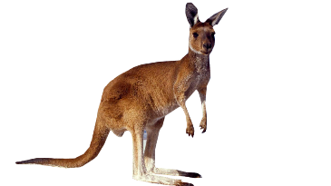
Kk Kangaroo
A MOB of Kangaroos
IMAGINA

Slide 13
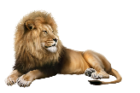
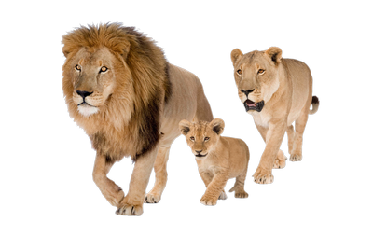

Ll Lion
A PRIDE of Lions
IMAGINA

Slide 14

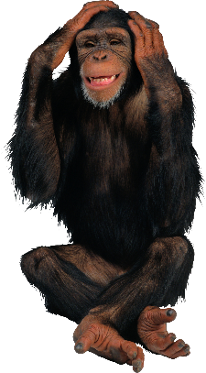
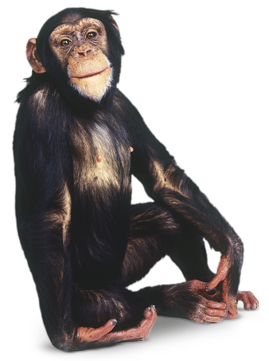
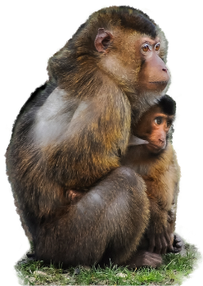
Mm Monkey
A TROOP of Monkey
IMAGINA
This Photo by Unknown Author is licensed under CC BY-NC
This Photo by Unknown Author is licensed under CC BY-NC

Slide 15
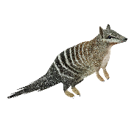
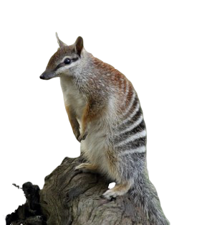
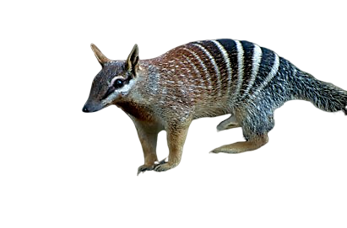
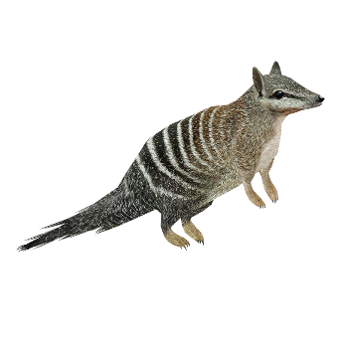


Nn Numbat
A CLOUD of Numbats
IMAGINA

Slide 16
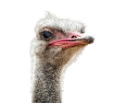
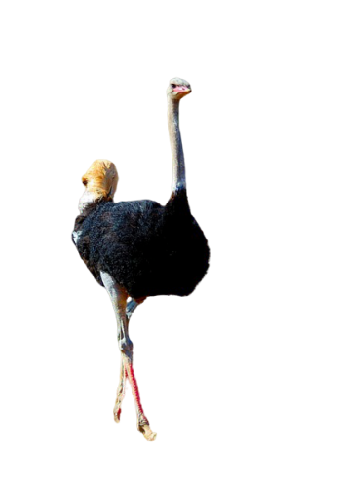
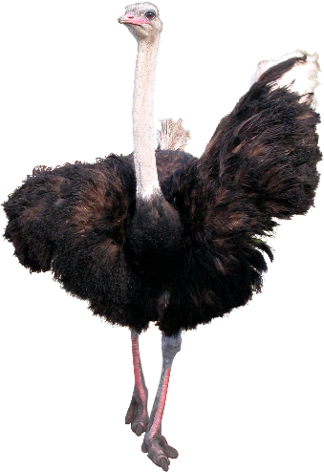
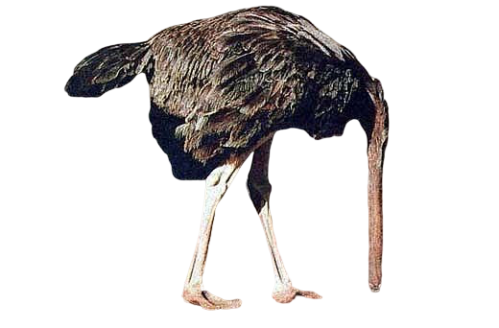
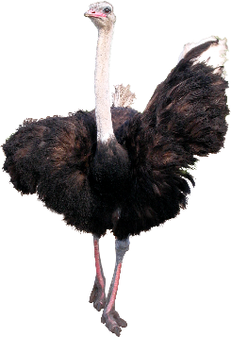
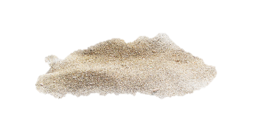
Oo Ostrich
A WOBBLE of Ostriches
IMAGINA

Slide 17
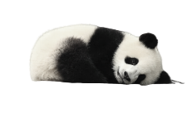
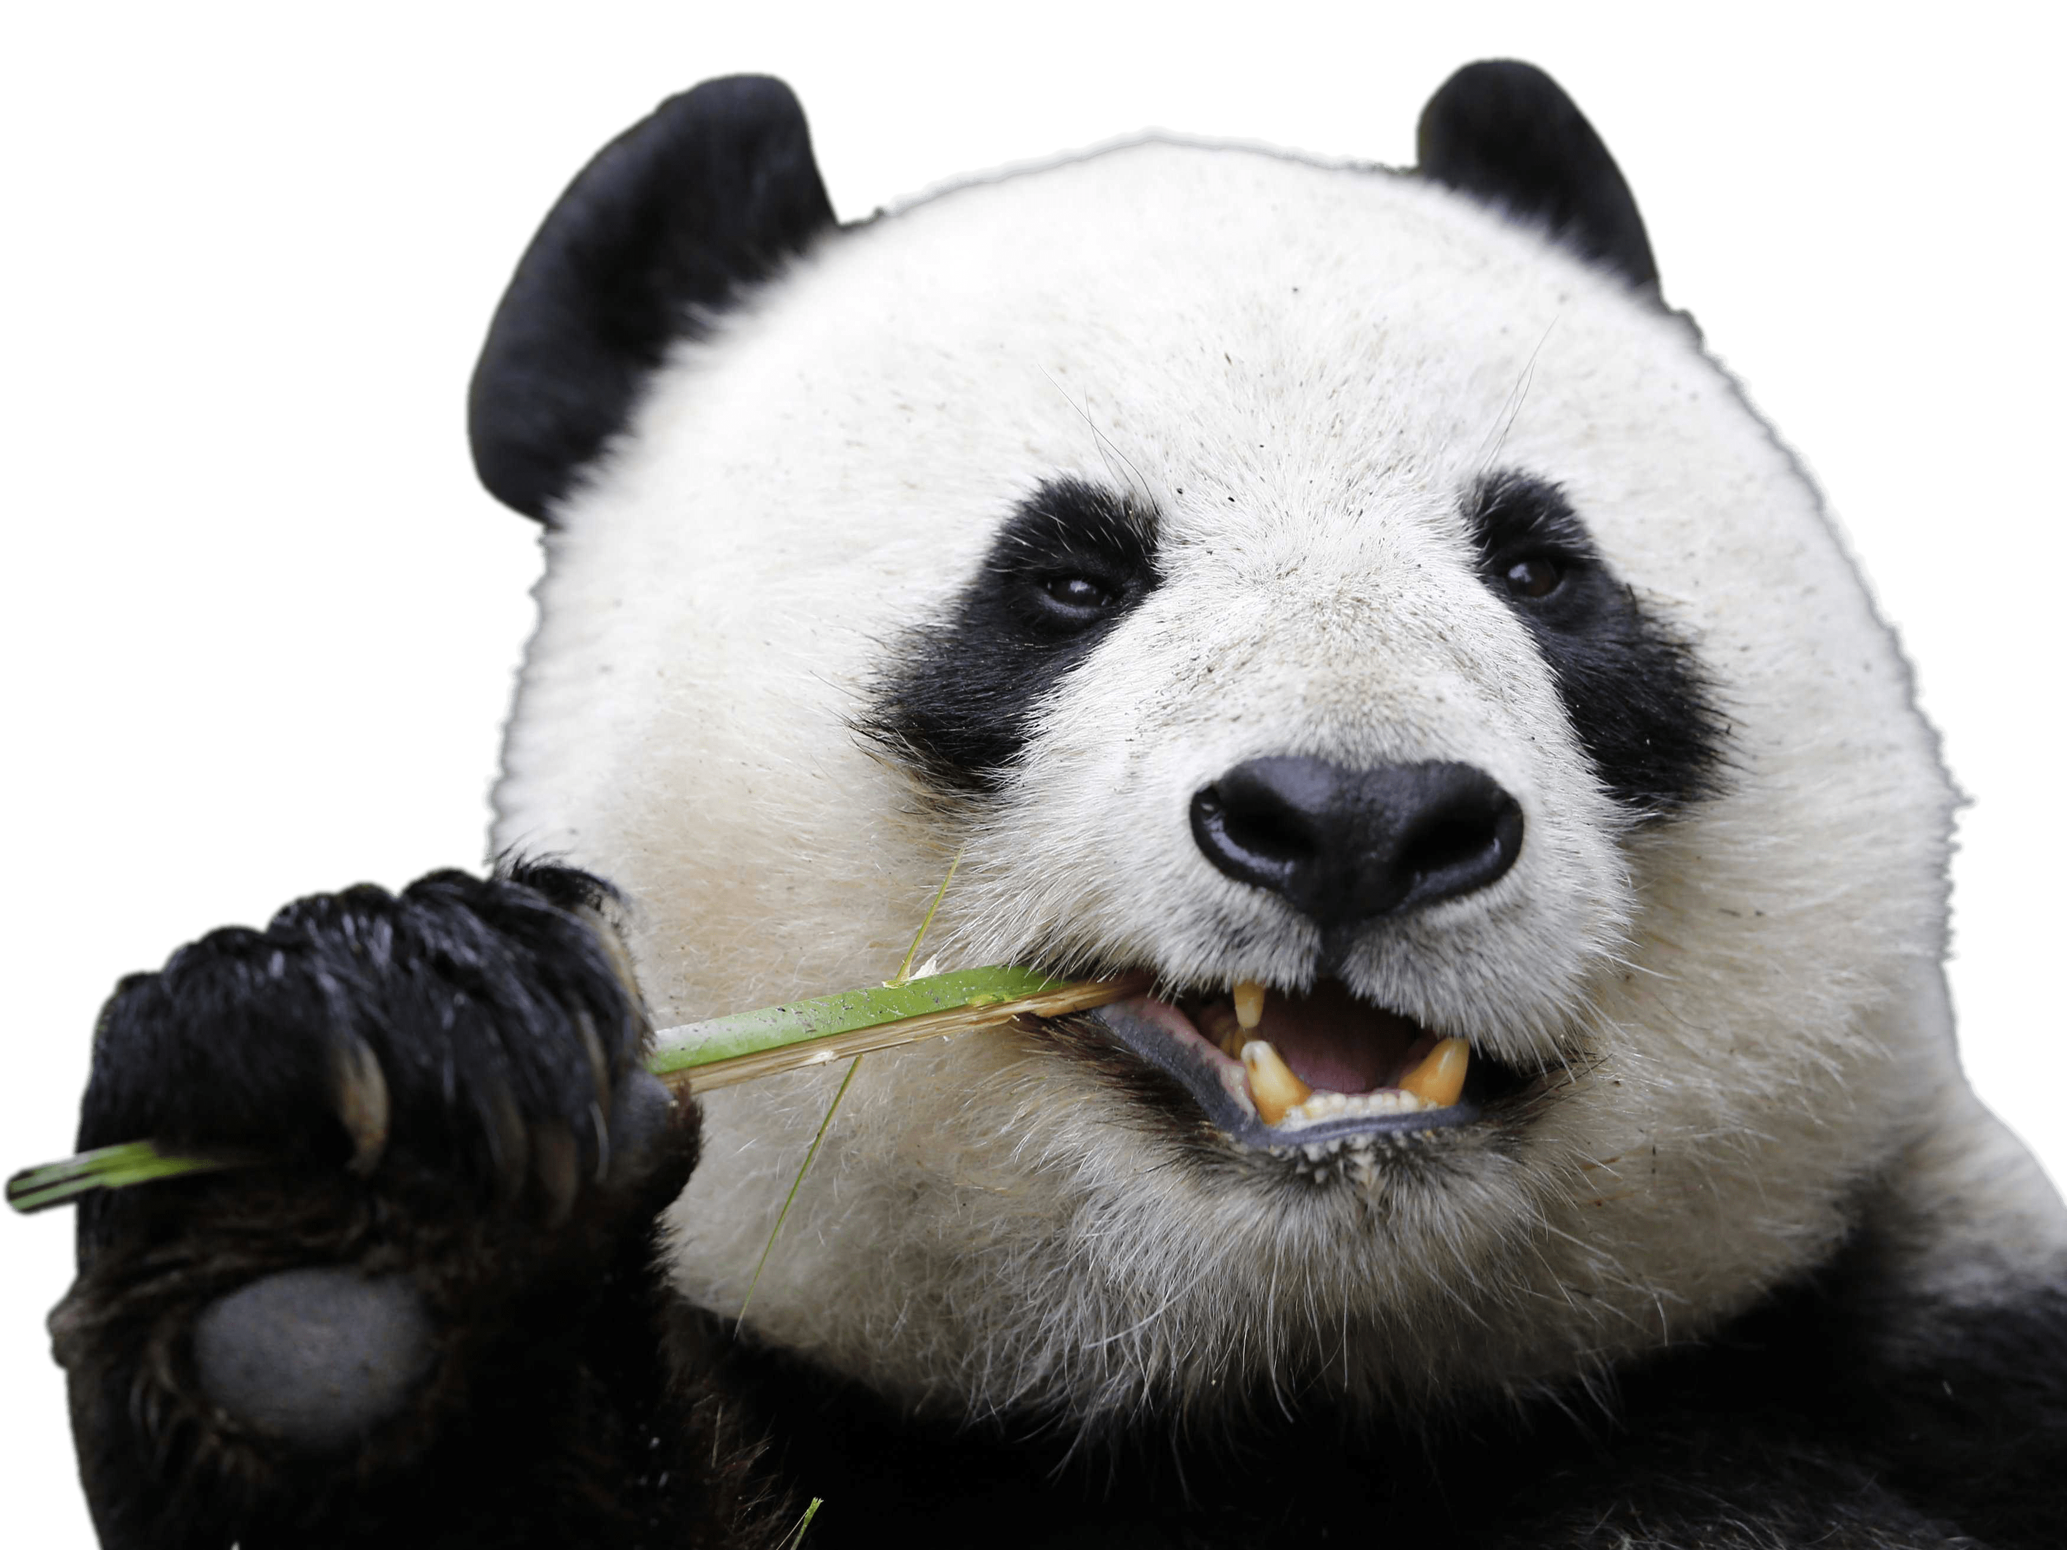




Pp Panda
An EMBARRASSMENT of Pandas
IMAGINA

Slide 18




Qq Quail
A COVEY of Quails
IMAGINA

Slide 19






Rr Rat
A MISCHIEF of Rats
IMAGINA

Slide 20




Ss Sloth
A BED of Sloths
IMAGINA

Slide 21




Tt Tiger
An AMBUSH of Tigers
IMAGINA

Slide 22




Uu Uakari
A TROOP of Uakaris
IMAGINA

Slide 23






Vv Vulture
A COMMITTEE of Vultures
IMAGINA

Slide 24





Ww Whale
A POD of Whales
IMAGINA

Slide 25





Xx Xantus’s Hummingbird
A CHARM of Xantus’s Hummingbirds
IMAGINA

Slide 26






Yy Yak
A HERD of Yaks
IMAGINA

Slide 27




Zz Zebra
A DAZZLE of Zebras
IMAGINA

Slide 28
THE END…
IMAGINA
For the love of learning…
Close Diary X
Re-open Diary >>>

